Slide 1

Topic 14
Searching and Simple Sorts
"There's nothing in your head the sorting hat can't see. So try me on and I will tell you where you ought to be."
-The Sorting Hat, Harry Potter and the Sorcerer's Stone

Slide 2
Sorting and Searching
Fundamental problems in computer science and programming
Sorting done to make searching easier
Multiple different algorithms to solve the same problem
  How do we know which algorithm is "better"?
Look at searching first
Examples use arrays of ints to illustrate algorithms
CS314
Searching and Simple Sorts

Slide 3


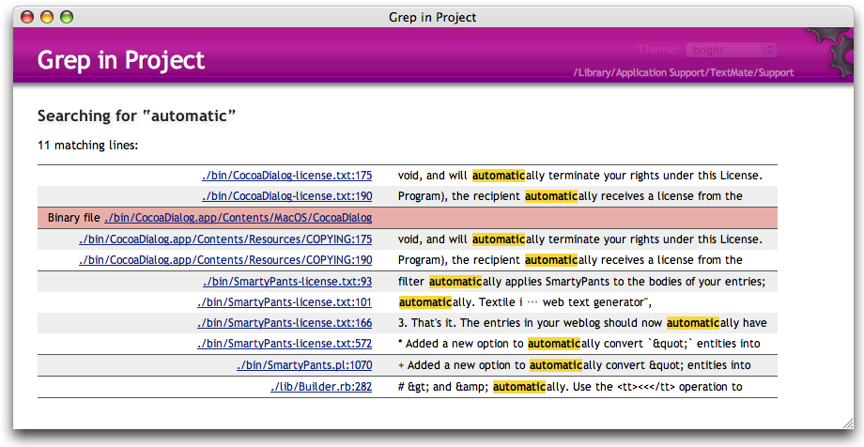

Searching

Slide 4

Searching
Given a list of data find the location of a particular value or report that value is not present
linear search
  intuitive approach?
  start at first item
  is it the one I am looking for?
  if not go to next item
  repeat until found or all items checked
If items not sorted or unsortable this approach is necessary
CS314
Searching and Simple Sorts

Slide 5
Linear Search
/* pre: list != null
post: return the index of the first occurrence
of target in list or -1 if target not present in
list
*/
public int linearSearch(int[] list, int target) {
for(int i = 0; i < list.length; i++)
if( list[i] == target )
return i;
return -1;
}
CS314
Searching and Simple Sorts

Slide 6
Linear Search, Generic
/* pre: list != null
post: return the index of the first occurrence
of target in list or -1 if target not present in
list
*/
public int linearSearch(Object[] list, Object target) {
for(int i = 0; i < list.length; i++)
if(target.equals(list[i]))
return i;
return -1;
}
T(N)? Big O? Best case, worst case, average case?
CS314
Searching and Simple Sorts

Slide 7
Attendance Question 1
What is the average case Big O of linear search in an array with N items, if an item is present?
O(N)
O(N²)
O(1)
O(logN)
O(NlogN)
CS314
Searching and Simple Sorts

Slide 8
Searching in a Sorted List
If items are sorted then we can divide and conquer
dividing your work in half with each step
  generally a good thing
The Binary Search on List in Ascending order
  Start at middle of list
  is that the item?
  If not is it less than or greater than the item?
  less than, move to second half of list
  greater than, move to first half of list
  repeat until found or sub list size = 0
CS314
Searching and Simple Sorts

Slide 9
Binary Search
list
low item middle item high item
Is middle item what we are looking for? If not is it
more or less than the target item? (Assume lower)
list
low middle high
item item item
and so forth…
CS314
Searching and Simple Sorts

Slide 10
Binary Search in Action
0 1 2 3 4 5 6 7 8 9 10 11 12 13 14 15
2
3
5
7
11
13
17
19
23
29
31
37
41
43
47
53
public static int bsearch(int[] list, int target) {
int result = -1;
int low = 0;
int high = list.length - 1;
while( result == -1 && low <= high ) {
int mid = low + ((high - low) / 2);
if( list[mid] == target )
result = mid;
else if( list[mid] < target)
low = mid + 1;
else
high = mid - 1;
}
return result;
}
// mid = ( low + high ) / 2; // may overflow!!!
// or mid = (low + high) >>> 1; using bitwise op
CS314
Searching and Simple Sorts

Slide 11
Trace When Key == 3
Trace When Key == 30
Variables of Interest?
CS314
Searching and Simple Sorts

Slide 12
Attendance Question 2
What is the worst case Big O of binary search in an array with N items, if an item is present?
O(N)
O(N²)
O(1)
O(logN)
O(NlogN)
CS314
Searching and Simple Sorts

Slide 13
Generic Binary Search
public static int bsearch(Comparable[] list, Comparable target) {
int result = -1;
int low = 0;
int high = list.length - 1;
while( result == -1 && low <= high ) {
int mid = low + ((high - low) / 2);
int compareResult = target.compareTo(list[mid]);
if( ompareResult == 0)
result = mid;
else if(compareResult > 0)
low = mid + 1;
else
high = mid - 1; // compareResult < 0
}
return result;
}
CS314
Searching and Simple Sorts

Slide 14
Recursive Binary Search
public static int bsearch(int[] list, int target) {
return bsearch(list, target, 0, list.length – 1);
}
public static int bsearch(int[] list, int target,
int low, int high) {
if( low <= high){
int mid = low + ((high - low) / 2);
if( list[mid] == target )
return mid;
else if( list[mid] > target )
return bsearch(list, target, low, mid – 1);
else
return bsearch(list, target, mid + 1, high);
}
return -1;
}
// is this a recursive backtracking algorithm?
CS314
Searching and Simple Sorts

Slide 15
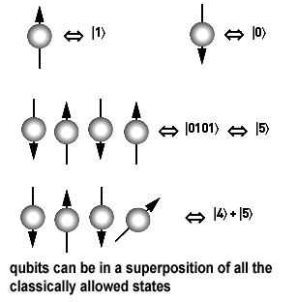
Other Searching Algorithms
Interpolation Search
  more like what people really do
Indexed Searching
Binary Search Trees
Hash Table Searching
Grover's Algorithm (Waiting for
quantum computers to be built)
best-first
A*
CS314
Searching and Simple Sorts

Slide 16
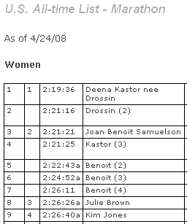
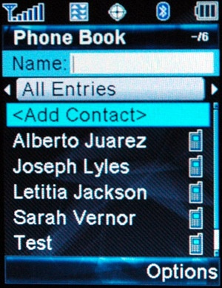
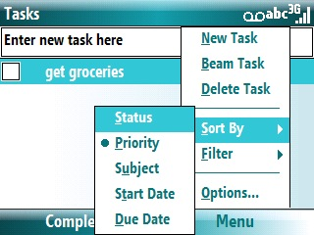
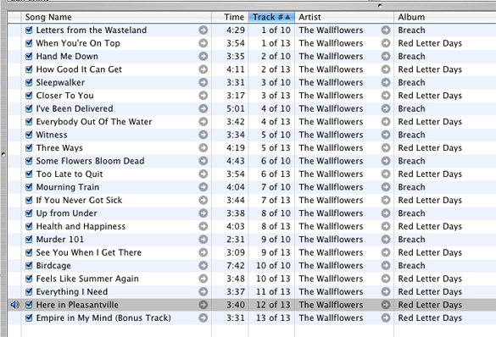
Sorting

Slide 17
Sorting
A fundamental application for computers
Done to make finding data (searching) faster
Many different algorithms for sorting
One of the difficulties with sorting is working with a fixed size storage container (array)
  if resize, that is expensive (slow)
The "simple" sorts run in quadratic time O(N²)
  bubble sort
  selection sort
  insertion sort
CS314
Searching and Simple Sorts

Slide 18
Selection sort
Algorithm
  Search through the list and find the smallest element
  swap the smallest element with the first element
  repeat starting at second element and find the second smallest element
public static void selectionSort(int[] list) {
for(int i = 0; i < list.length - 1; i++) {
int min = i;
for(int j = i + 1; j < list.length; j++)
if( list[j] < list[min] )
min = j;
int temp = list[i];
list[i] = list[min];
list[min] = temp;
}
}
CS314
Searching and Simple Sorts

Slide 19
Selection Sort in Practice
44 68 191 119 119 37 83 82 191 45 158 130 76 153 39 25
What is the T(N), actual number of statements executed, of the selection sort code, given a list of N elements? What is the Big O?
CS314
Searching and Simple Sorts

Slide 20
Generic Selection Sort
public void selectionSort(Comparable[] list) {
Comparable temp;
for(int i = 0; i < list.length - 1; i++) {
int min = i;
for(int j = i + 1; j < list.length; j++)
if( list[min].compareTo(list[j]) > 0 )
min = j;
temp = list[i];
list[i] = list[min];
list[min] = temp;
}
}
CS314
Searching and Simple Sorts

Slide 21
Insertion Sort
Another of the O(N²) sorts
The first item is sorted
Compare the second item to the first
  if smaller swap
Third item, compare to item next to it
  need to swap
  after swap compare again
And so forth…
CS314
Searching and Simple Sorts

Slide 22
Insertion Sort Code
public void insertionSort(int[] list) {
for(int i = 1; i < list.length; i++) {
int temp = list[i];
int j = i;
while( j > 0 && temp < list[j - 1]){
// swap elements
list[j] = list[j - 1];
list[j - 1] = temp;
j--;
}
}
}
Best case, worst case, average case Big O?
CS314
Searching and Simple Sorts

Slide 23
Comparing Algorithms
Which algorithm do you think will be faster given random data, selection sort or insertion sort?
Insertion Sort
Selection Sort
About the same
CS314
Searching and Simple Sorts

